Slide 1
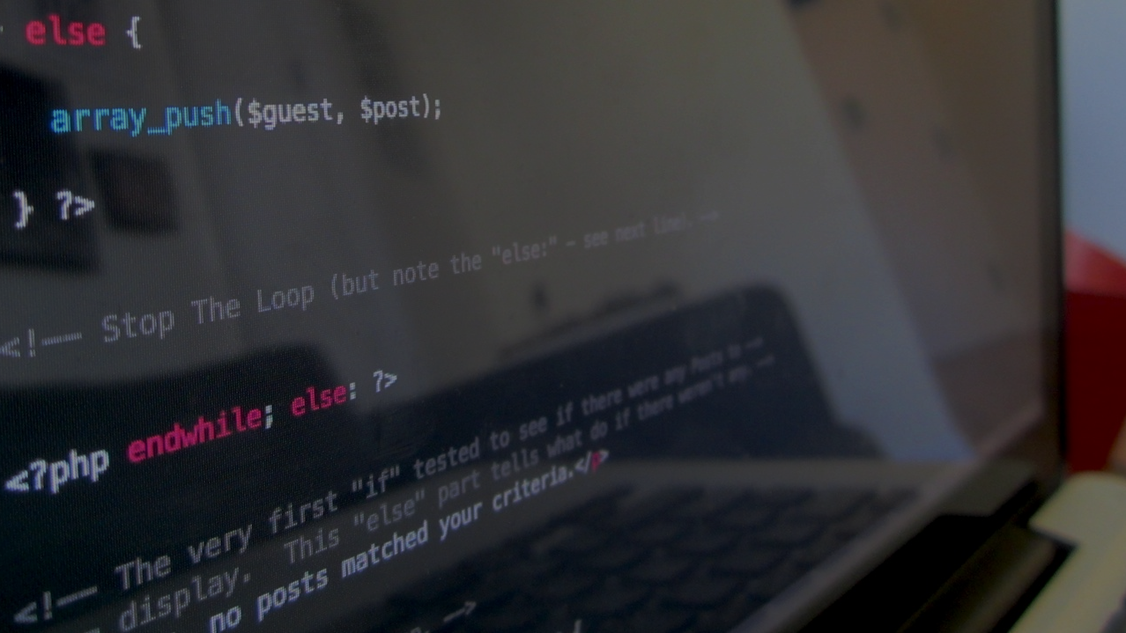

The first Hub for Developers
Agile Methodologies

Slide 2
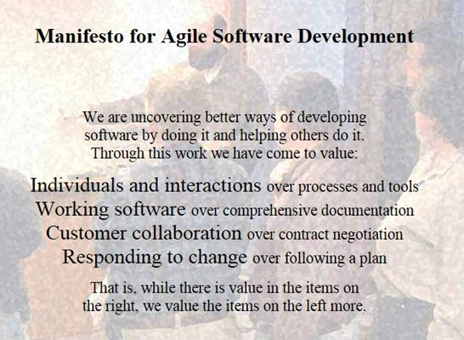
Contents
What is agile
Agile methodologies
Scrum
Kanban
Demo

Slide 3
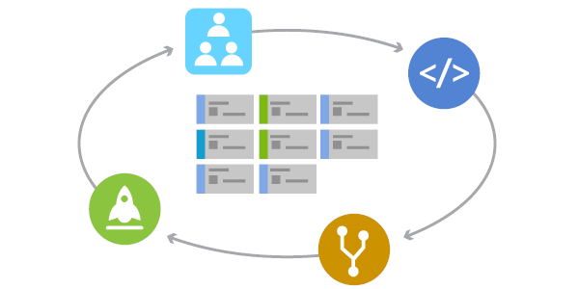
What is agile
Agile is a term used to describe approaches to software development emphasizing incremental delivery, team collaboration, continual planning, and continual learning. The term “Agile” was coined in 2001 in the Agile Manifesto.
Agile Values
Individuals and interactions over processes and tools
Working software over comprehensive documentation
Customer collaboration over contract negotiation
Responding to change over following a plan
Agile is not a thing, you don’t “do Agile”. Rather, agile is a mindset
Notes:
It’s important to understand that agile is not a “thing” … you don’t “do Agile”. Rather, agile is a mindset. A mindset that drives an approach to software development. There’s not one approach here that works for all situations, rather the term “Agile” has come to represent a variety of methods and practices that align with the value statements in the manifesto.
Agile methods (often called frameworks) are comprehensive approaches to phases of the software development lifecycle – planning, execution, and delivery. They prescribe a method for accomplishing work, with clear guidance and principles

Slide 4
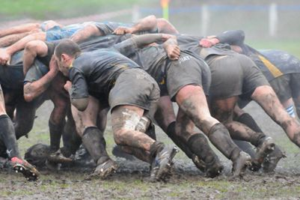
What agile isn’t
Agile is not cowboy coding
Agile is not without rigor and planning
Agile is not an excuse for the lack of a roadmap
Agile is not development without specifications
Notes:
It’s important to understand that agile is not a “thing” … you don’t “do Agile”. Rather, agile is a mindset. A mindset that drives an approach to software development. There’s not one approach here that works for all situations, rather the term “Agile” has come to represent a variety of methods and practices that align with the value statements in the manifesto.
Agile methods (often called frameworks) are comprehensive approaches to phases of the software development lifecycle – planning, execution, and delivery. They prescribe a method for accomplishing work, with clear guidance and principles

Slide 5
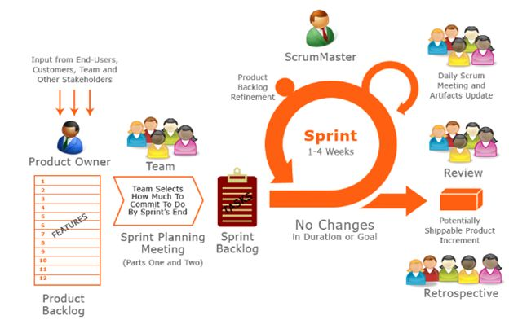
Scurm
Agile development is a term used to describe iterative software development. Iterative software development shortens the software development lifecycle. Agile development teams execute the entire software development lifecycle in smaller increments, usually called sprints.
2 major types:
Scrum
Kanban
Notes:
It’s important to understand that agile is not a “thing” … you don’t “do Agile”. Rather, agile is a mindset. A mindset that drives an approach to software development. There’s not one approach here that works for all situations, rather the term “Agile” has come to represent a variety of methods and practices that align with the value statements in the manifesto.
Agile methods (often called frameworks) are comprehensive approaches to phases of the software development lifecycle – planning, execution, and delivery. They prescribe a method for accomplishing work, with clear guidance and principles

Slide 6
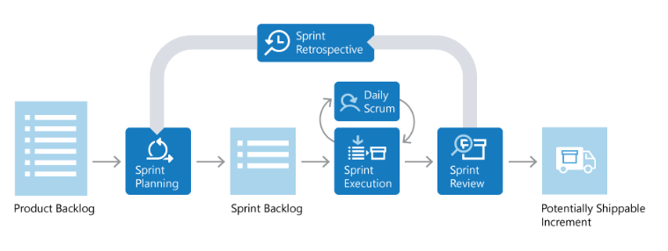
The scrum lifecycle
.
Notes:
Scrum Roles
Scrum prescribes three specific roles…
Product Owner
Responsible for what the team is building, and why they’re building it. The product owner is responsible for keeping the backlog up-to-date and in priority order.
Scrum Master
Responsible to ensure the scrum process is followed by the team. Scrum masters are continually on the lookout for how the team can improve, while also resolving impediments (blocking issues) that arise during the sprint. Scrum masters are part coach, part team member, and part cheerleader.
Scrum Team
These are the individuals that actually build the product. The team owns the engineering of the product, and the quality that goes with it.
Product Backlog
The Product Backlog is a prioritized list of value the team can deliver. The Product Owner owns the backlog and adds, changes, and reprioritizes as needed. The items at the top of the backlog should always be ready for the team to execute on.
Sprint Planning and Sprint Backlog
In Sprint Planning, the team chooses the backlog items they will work on in the upcoming sprint. The team chooses backlog items based on priority and what they believe they can complete in the sprint. The Sprint Backlog is the list of items the team plans to deliver in the sprint. Often, each item on the Sprint Backlog is broken down into tasks. Once all members agree the Sprint Backlog is achievable, the Sprint starts.
Sprint Execution and Daily Scrum
Once the Sprint starts, the team executes on the Sprint Backlog. Scrum does not specify how the team should execute. That is left for the team to decide.
Scrum defines a practice called a Daily Scrum, often called the Daily Standup. The Daily Scrum is daily meeting limited to 15 minutes. Team members often stand during the meeting, to ensure it stays brief. Each team member briefly reports their progress since yesterday, the plans for today, and anything impeding their progress.
To aid the Daily Scrum, teams often review two artifacts:
The Task Board
The Sprint Burndown
Sprint Review and Sprint Retrospective
At the end of the Sprint, the team performs two practices:
Sprint Review
The team demonstrates what they’ve accomplished to stakeholders. They demo the software and show its value.
Sprint Retrospective
The team takes time to reflect on what went well and which areas need improvement. The outcome of the retrospective are actions for next sprint.
Increment
The product of a Sprint is called the “Increment” or “Potentially Shippable Increment”. Regardless the term, a Sprint’s output should be of shippable quality, even if it’s part of something bigger and can’t ship by itself. It should meet all the quality criteria set by the team and Product Owner.
Repeat. Learn. Improve.
The entire cycle is repeated for the next sprint. Sprint Planning selects the next items on the Product Backlog and the cycle repeats. While the team is executing the Sprint, the Product Owner is ensuring the items at the top of the backlog are ready to execute in the following Sprint.
This shorter, iterative cycle provides the team with lots of opportunities to learn and improve. A traditional project often has a long lifecycle, say 6-12 months. While a team can learn from a traditional project, the opportunities are far less than a team who executes in 2-week sprints, for example.
This iterative cycle is, in many ways, the essence of Agile.
Scrum is very popular because it provides just enough framework to guide teams, while giving them flexibility in how they execute. Its concepts are simple and easy to learn. Teams can get started quickly and learn as they go. All of this makes Scrum a great choice for teams just starting to implement Agileprinciples.

Slide 7
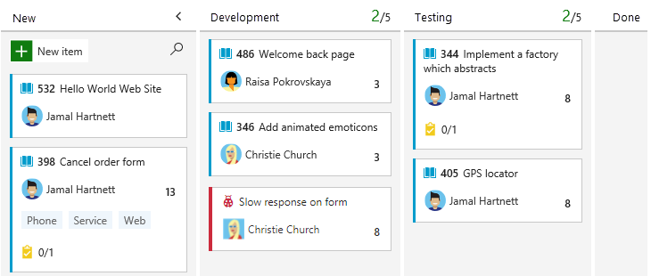
Kanban boards

Slide 8

Demo Create an Kanban board on Azure Boards
Notes:
In-Browser tutorial:
www.dot.net → Get Started → Select In-browser tutorial
https://www.microsoft.com/net/learn/in-browser-tutorial/1
-- Have the class walk through some of the lessons.

Slide 9
Demo Planning In the classroom
Notes:
In-Browser tutorial:
www.dot.net → Get Started → Select In-browser tutorial
https://www.microsoft.com/net/learn/in-browser-tutorial/1
-- Have the class walk through some of the lessons.

